Slide 1





Teach Together
HOME SIGN UP LOGIN ABOUT LESSON PLAN GENERATOR
WELCOME TO TEACH TOGETHER
Create Unit Plans aligned with the Common Core Standards
Build Lesson Plans to align with your units or to stand alone
Collaborate with other teachers to ensure all students are learning all core content
Click here for our FREE and easy to use Unit and Lesson Plan Generator. It’s Common Core aligned and designed to make your life easier!
Hint: Become a member to save, update and share all your documents
Login
Sign Up
Learn More
Have any tips, suggestions or comments for us? We’d love to hear from you!

Slide 2
Teach Together
HOME SIGN UP LOGIN ABOUT LESSON PLAN GENERATOR
X
LOGIN TO TEACH TOGETHER
WELCOME TO TEACH TOGETHER
Create Unit Plans aligned with the Common Core Standards
Build Lesson Plans to align with your units or to stand alone
Collaborate with other teachers to ensure all students are learning all core content
Enter your login information below to access your account.
EMAIL :
PASSWORD :
Click here for our FREE and easy to use Unit and Lesson Plan Generator. It’s Common Core aligned and designed to make your life easier!
LOGIN
Hint: Become a member to save, update and share all your documents
Login
Sign Up
Learn More
Not a member?
Sign Up Here!
Have any tips, suggestions or comments for us? We’d love to hear from you!

Slide 3
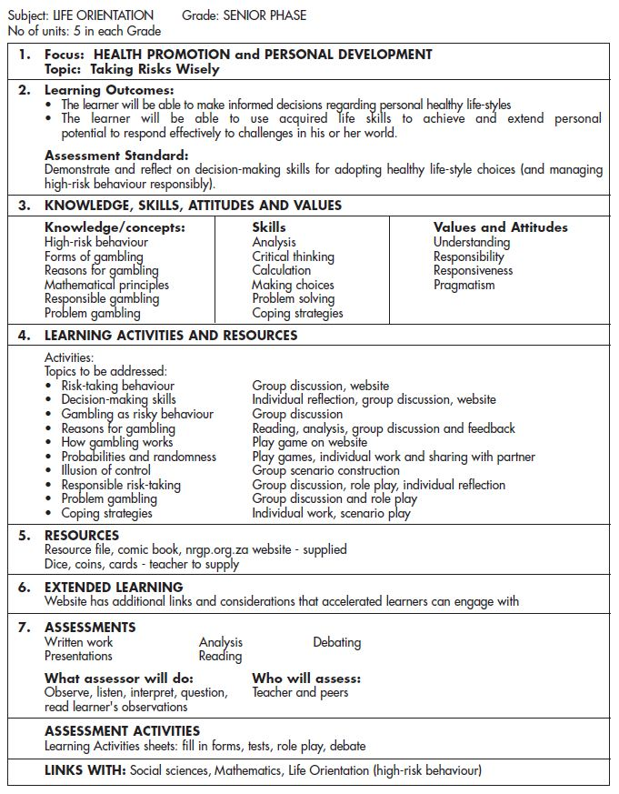
Teach Together
WELCOME BACK, TAYLOR!
Sign Out?
HOME YOUR GROUPS LESSON PLAN GENERATOR
Your Unit Plans
Your Unit Plans
Adding Fractions
November 15th, 205
Subtracting Fractions
November25th, 205
Multiplying Fractions
December 24th, 205
New Unit Plan
New Lesson Plan
Your Groups
Dividing Fractions
December 11th, 205
Polynomials
December 31th, 205
Prime Numbers
January 10th, 2016
Have any tips, suggestions or comments for us? We’d love to hear from you!

Slide 4
Teach Together
WELCOME BACK, TAYLOR!
Sign Out?
HOME YOUR GROUPS LESSON PLAN GENERATOR
Create a New Unit Plan
Your Unit Plans
Teacher Name:
New Unit Plan
Unit Title:
New Lesson Plan
Your Groups
Description:
Start Date:
End Date:
Standard
Add Standard
Activities
v
Materials
Have any tips, suggestions or comments for us? We’d love to hear from you!

Slide 5



Teach Together
WELCOME BACK, TAYLOR!
Sign Out?
HOME YOUR GROUPS LESSON PLAN GENERATOR
Your New Unit Plans
Your Unit Plans
Health Promotion Unit Plan
November 15th – December 9th, 2016
New Unit Plan
New Lesson Plan
Your Groups
Save
Print
View All
Have any tips, suggestions or comments for us? We’d love to hear from you!

